Slide 1



EU's Consumer Goods Industry
Driving a Competitive EU - the figures!
AIM, the European Brands Association, represents 2,500 branded consumer goods manufacturers in Europe in the food, beverages, personal care, home care, luxury, toys, apparel and electronic equipment categories. Our members are small, medium, and large companies, with brands ranging from national household names to global icons, all intent on delivering trusted and high-quality goods to consumers across Europe.

Slide 2

Consumption is a key contributor to the economy. The consumer goods industry is an essential motor of the EU economy driven by FMCG Brands
¹
Household consumption
51%
²
of EU GDP
€652 Billion
8,1%
Households spent
€652 billion
on FMCG brands consumed at home
Representing
FMCG Brands
8,1%
of total household consumption
Other Household consumption
Source: Eurostat 2022 GDP
and main components, Euromonitor for brands data
¹ FMCG Brands: Packaged Food, Pet Care, Health & Beauty, Household Cleaning Products, Paper Tissue & Hygiene, Non alcoholic and Alcoholic Drinks purchased in Stores, consumption made at Home. EU 24.. No data for Petcare in Latvia, Lithuania and Slovenia | ² Household Consumption: Food and non-alcoholic beverages; Clothing and footwear; Housing, water, electricity, gas and other fuels; Furnishings, household equipment and routine household maintenance; Health;Transport, Communication, Recreation & Entertainment including Culture; Restaurants and hotels; Miscellaneous goods and services.

Slide 3





Europe’s fast-moving-consumer-goods industry
is one of the strongest contributors to the EU’s industrial base
3rd
Sold
production
of all manufactured goods
produced in the EU
largest
11,6%
manufacturing
industry in Europe
€714,5
Billion
FMCG sold production in the EU
11,60%
1118,5
872
89,40%
714,5
639
562
508
313
FMCG
Others
Basic metals and fabricated metal products
Chemicals
FMCG*
Car Manufacturing
Machinery & Equipment
Rubber & Plastic
High Tech Products
Source: Eurostat, Prodcom, 2022 data

Slide 4






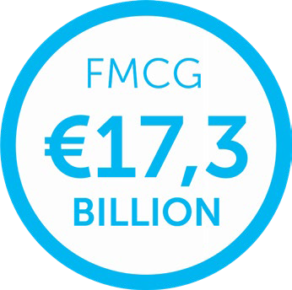
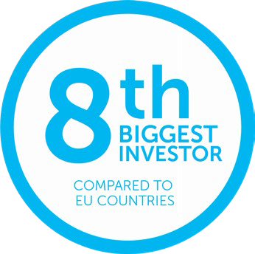

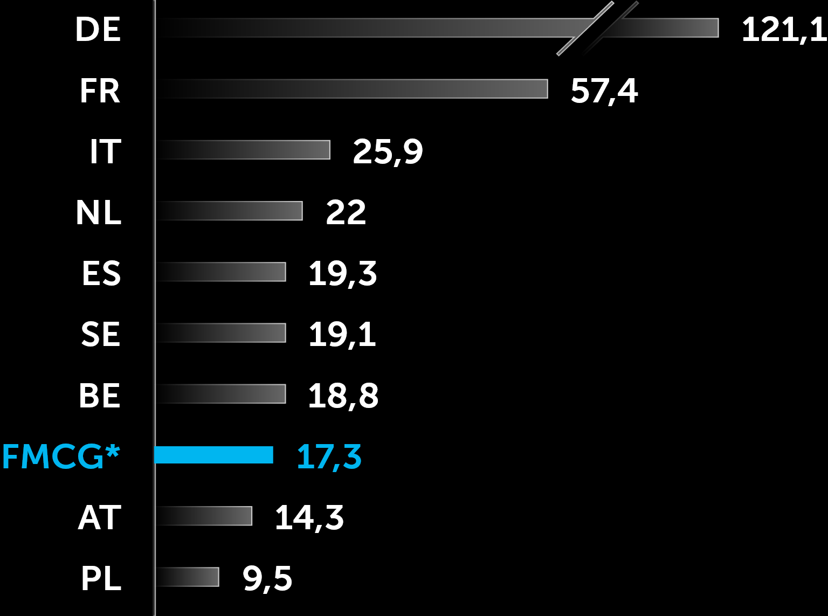






The branded consumer goods industry innovates & invests in the EU,
providing high quality jobs and driving EU industrial strategy and competitiveness
Total R&D Expenditure in the EU
EU’s FMCG
industry
100%
€353.9 billion
66%
33%
Has been funded by Private Sector
€234.4 Billion
Public Sector
€119.5 Billion
Invested €145.3 billion
in R&D in the past decade 2012-2022
Source: OECD, Eurostat 2022 - Gross domestic expenditure on R&D (GERD) - EU 26, no data for DK
35 of AIM’s corporate members are included in the
top 2,500 companies investing in R&D globally
FMCG companies
in the EU invested
€81 Billion
AIM’s corporate members invested €34.8 billion globally in R&D in 2022. In the last 12 years, these 35 AIM corporate members invested over €285,9 Billion
in R&D globally
€64.5
Billion
in industrial assets
20.4%
of the total manufacturing investment (Capex)
in the EU
€16.5
Billion
in R&D
Sources: R&D 2021: Euromonitor based on Eurostat BERD | Capex: Eurostat: SBS by detailed NACE Rev.2 activity Gross investment in tangible non-current assets
Sources: 2022 data, Euromonitor based on Eurostat BERD (Business Entreprise R&D), by NACE 4 digit codes, no data for Cyprus, Luxembourg, Malta and the NL | The 2023 EU Industrial R&D Investment Scoreboard | IRI (europa.eu)

Slide 5





Consumer goods industry provides choice to consumers across the EU, supporting the Single Market. Consumers & households trust our brands, within and outside the EU
€450.9 billion
of FMCG products traded within and outside the EU:
61% 39%
(€276.1 billion)
of FMCG goods are traded within the
EU’s single market
(€174.8 billion)
are exported outside of the EU
6,5%
6,8%
of total
Intra-EU27 trade
of total
Extra-EU27 trade
The FMCG industry has provided a positive trade balance
for the EU in the past decade, with continuous growth
FMCG trade balance represented
Intra EU export
€94.1 Bn
€54.7 Bn
Extra EU import
33%
of the EU’s total trade
(goods and services)
FMCG
Others
2013 2014 2015 2016 2017 2018 2019 2020 2021 2022
Source: 2022 Euromonitor based on Eurostat using HS codes, Trade by commodity

Slide 6



A highly competitive private sector, including the branded consumer goods industry, is a major
contributor to government resources, it supports communities through the payment of numerous taxes
41.2%
61%
90%
Tax revenues account for 41.2% of the EU’s GDP
= €6.5 trillion
of taxes are paid
by the private sector
Proportion of Government
Revenues from Taxes
of taxes received
in the European Union
(VAT, other taxes on production
& duties on imports; employers
social contribution for employees, taxes on profits)
Source :2022 Eurostat, gov_10a_taxag_custom

Slide 7







The FMCG
Industry
The FMCG branded industry supports household purchasing power with higher
wages & salaries than other economic sectors, providing high quality jobs
Average annual
gross wages and salaries
Employed
3,148,317
people in the EU
Source: 2021 Eurostat, SBS, Enterprises by detailed NACE Rev.2 activity and special aggregates
Paid
€122 Billion
in salaries and social
contributions
  Source: 2021 Eurostat, SBS, Employee benefits expenses incl. social contribution Enterprises by detailed NACE Rev.2 activity
  Source: 2021 Eurostat, SBS , Employee benefits expenses incl. social contribution Enterprises by detailed NACE Rev.2 activity

Slide 8





Contact
AIM - European Brands Association
Avenue de Gaulois 9 B-1040 Brussels Belgium EU Transparency register
ID no.: 1074382679-01
Website: www.aim.be
Tel: +32 2 736 03 05
Email: brandaim@aim.be

